Slide 1
INTELLIGENT SEARCH ENGINE

Slide 2


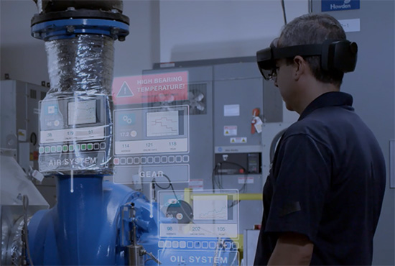
Business Problem
“A shortage of skilled labor is one of the evolving problems in manufacturing. AR technology can speed up workforce training in addition to decreasing work-related injuries, cutting operational costs, and increasing productivity using digital workflows.”
“It requires a very advanced and rich system to find any
relevant information within enterprise documentation.”

Slide 3
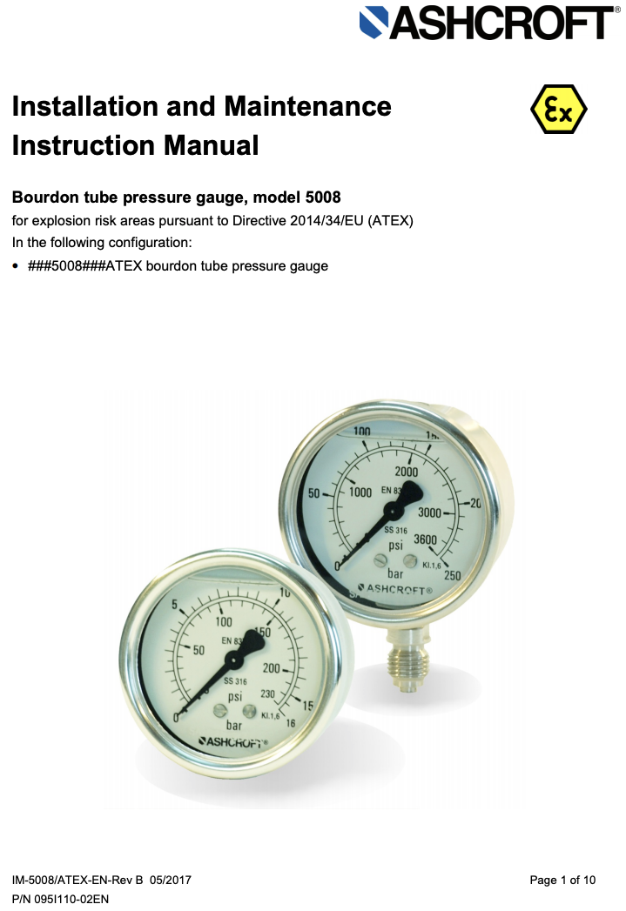
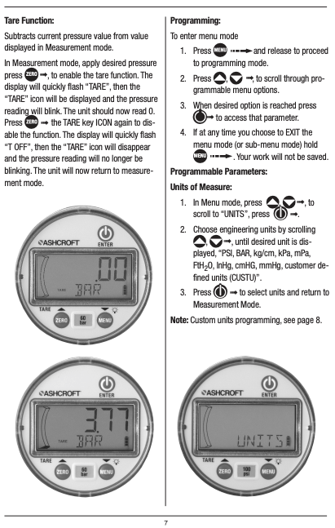
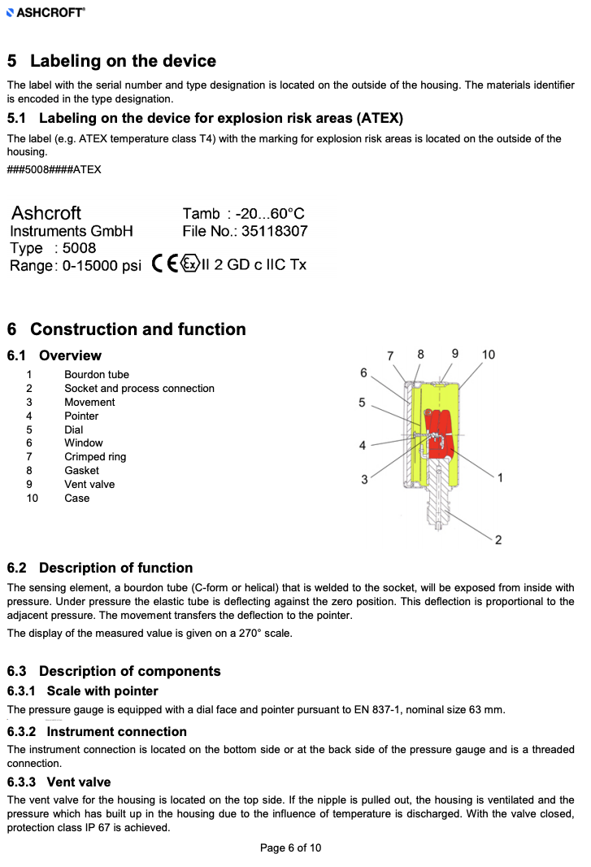
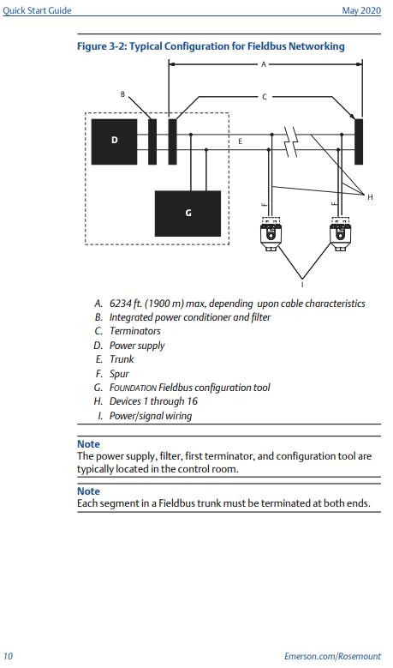
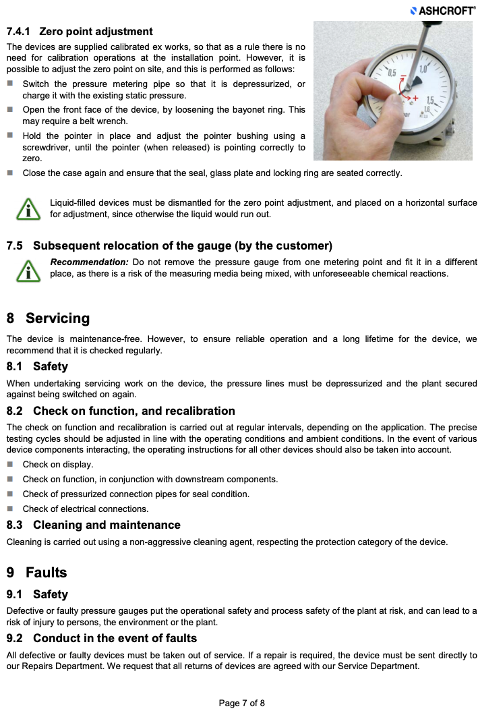
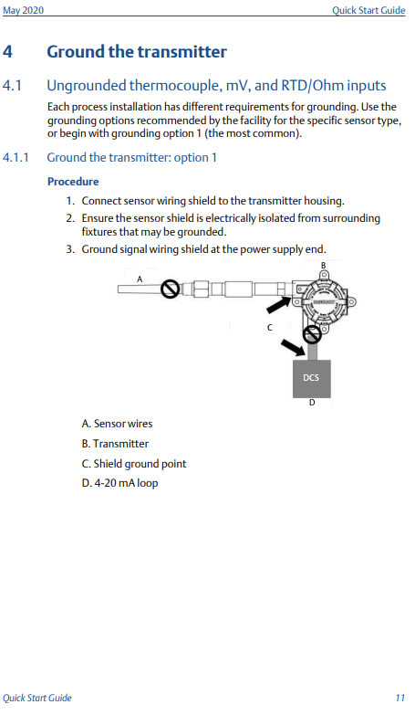
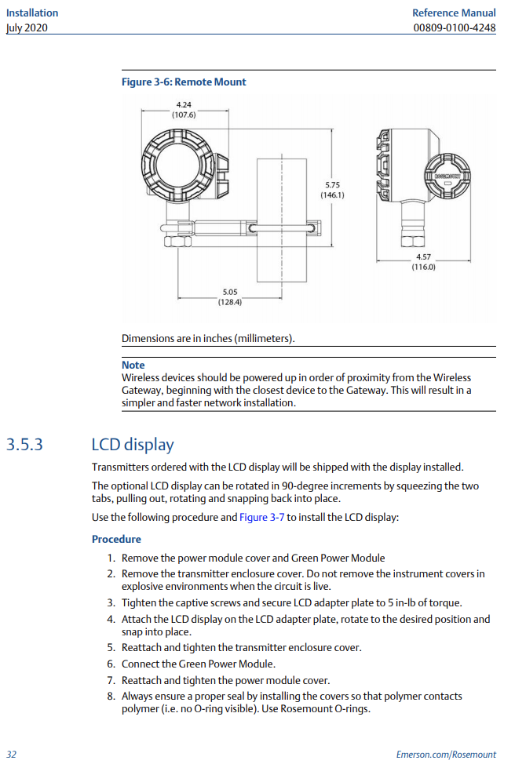
DATA
Readable and scanned PDF manuals of products;
For Hackathon purposes, Emerson and Ashcroft products documents are used which include:
- Measurement Instrumentation;
- Valves, actuators, and regulators;
- Other Sensors and transmitters.
More than 1,000 documents;

Slide 4
Solution

Slide 5
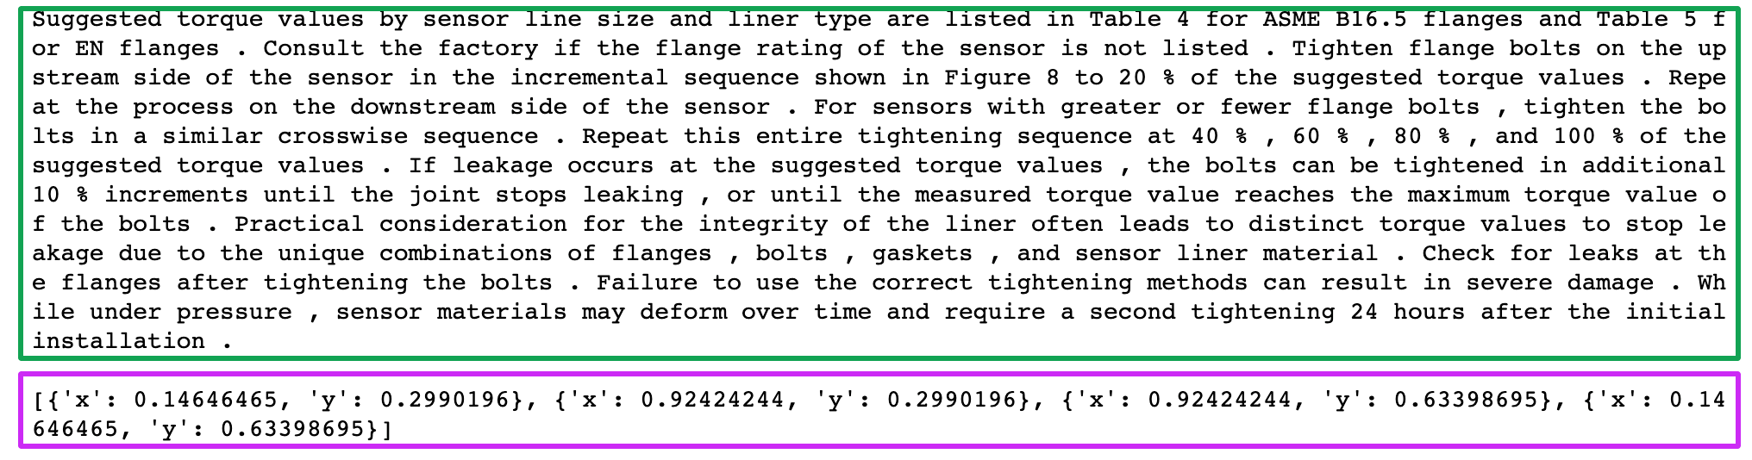
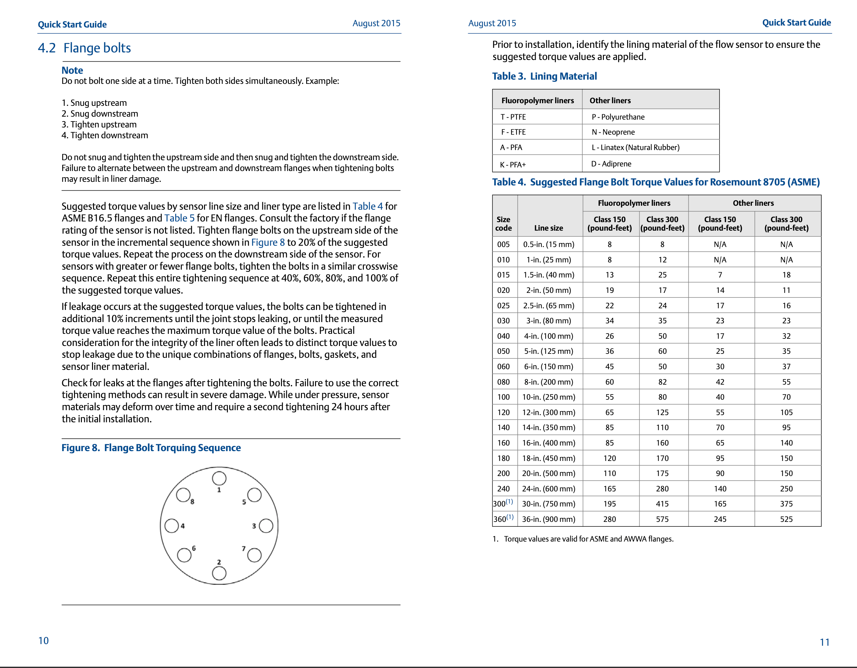
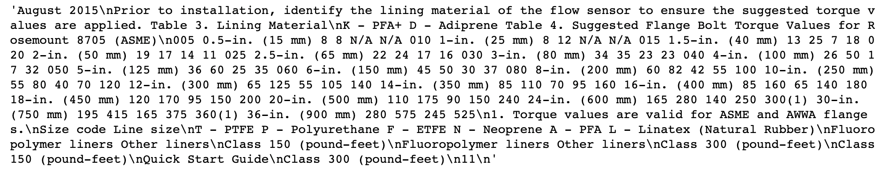
INPUT DATA
Set of JSONs
Set of PDFs

Slide 6
Project Steps

Slide 7

Text Extraction
Text Preprocessing
GCP Vision
Previously Done
Data set creating
Hyphen or Spaces Removing
Unuseful Text Removing
Paragraphs Joining
Other
Split Text into Sentences
Split Sentence into Words
Identify Pages, Documents Names for Texts
Other

Slide 8
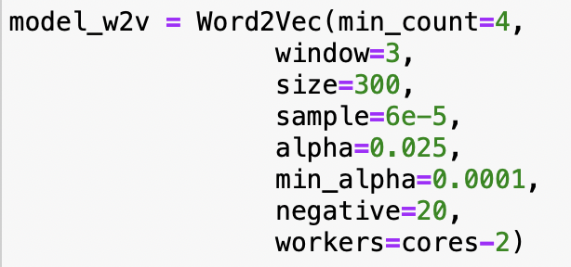
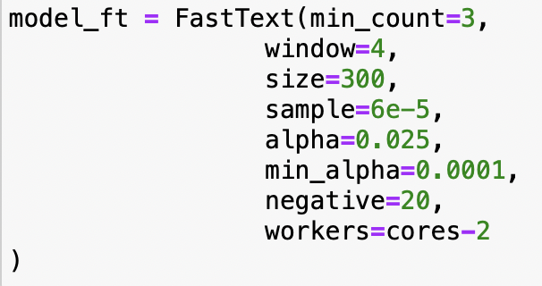
Modelling
Text Preprocessing:
- Stop Words
- Duplicates
- Very short words
Word2Vec
FastText
Normalization
Other

Slide 9
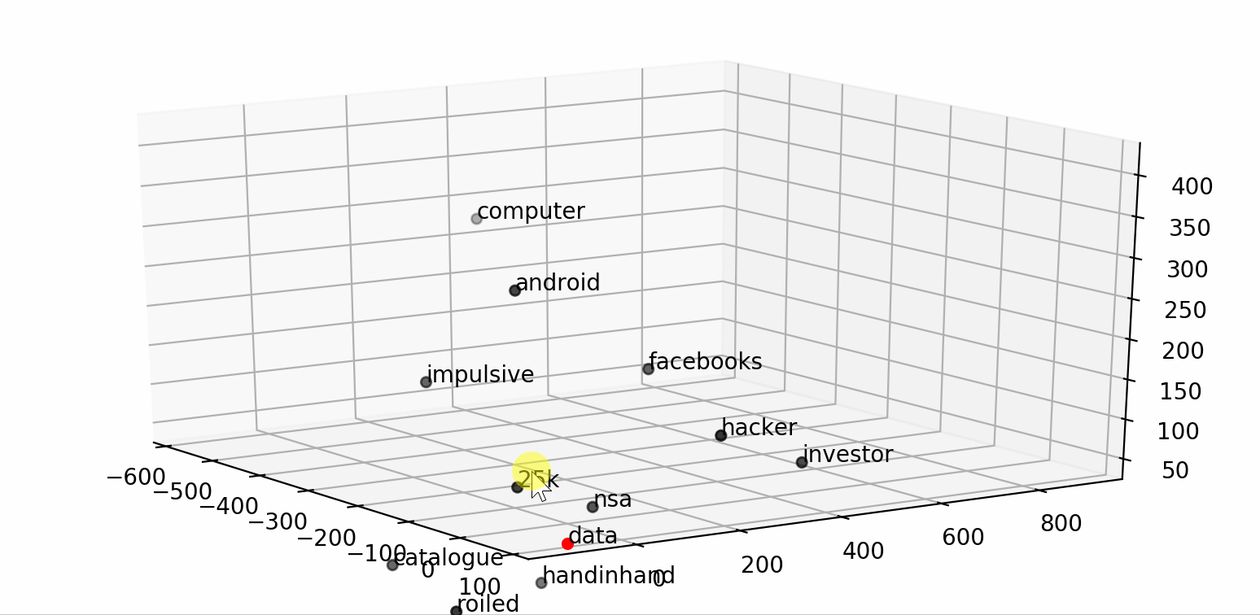
Vector Creating
Extend Dataset with Vectors
Grouping Data

Slide 10
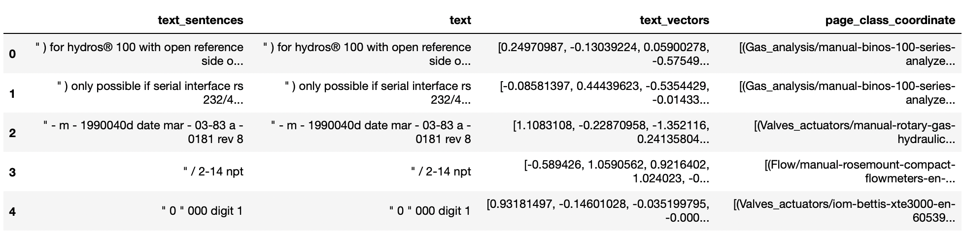
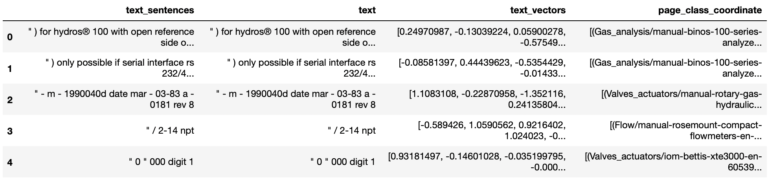
Data set Examples
Data set for Word2Vec model
Data set for FastText model

Slide 11
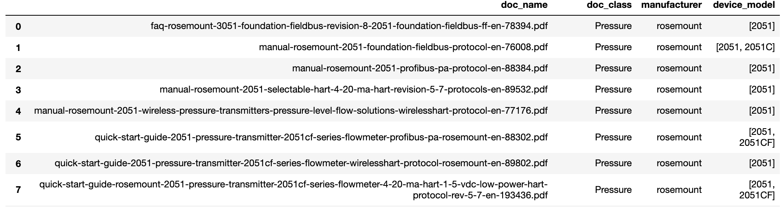
Document to device map

Slide 12
How does it work?
daniel 1500 parts list
level meter t-200 length verification
micro motion 2500 how to lock
burner maintenance

Slide 13
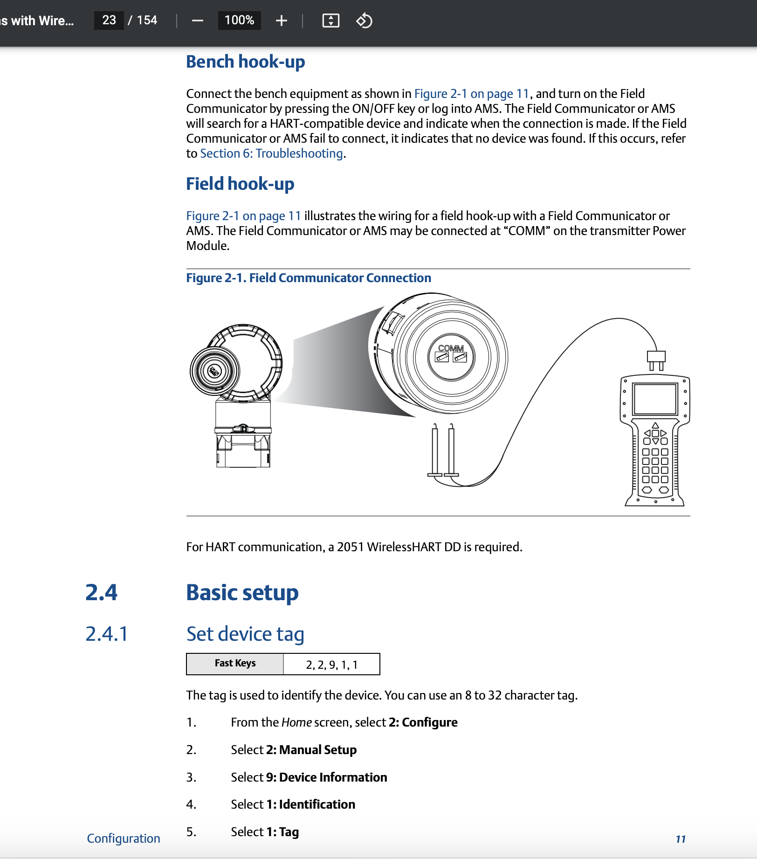
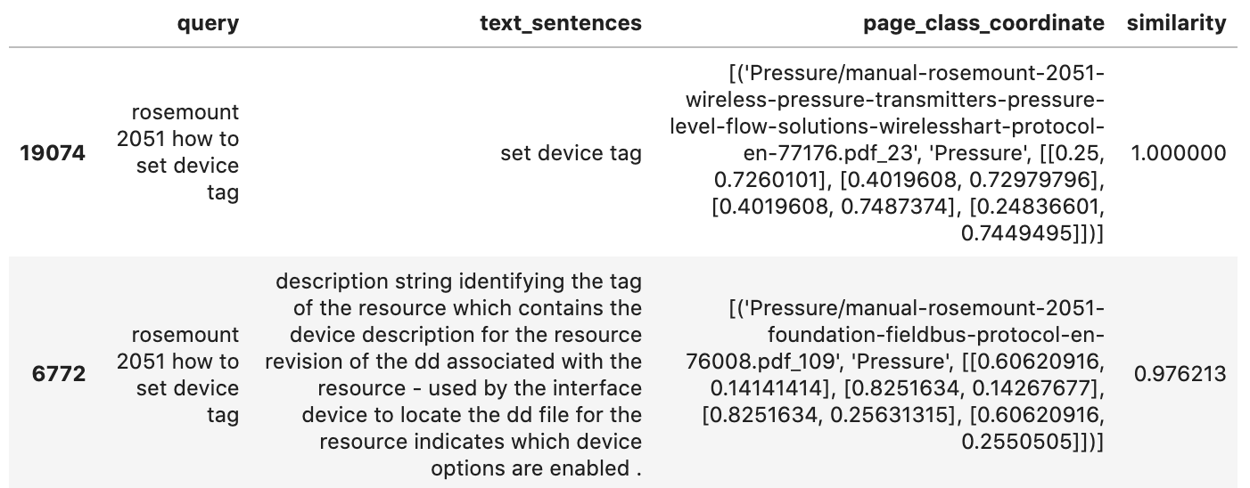
How does it work?
rosemount 2051 how to set device tag

Slide 14
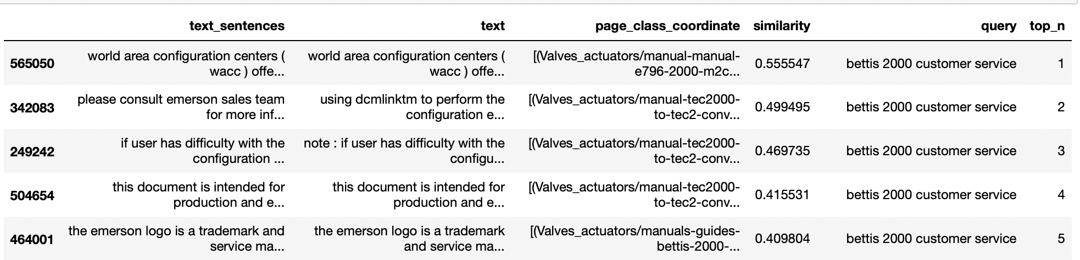
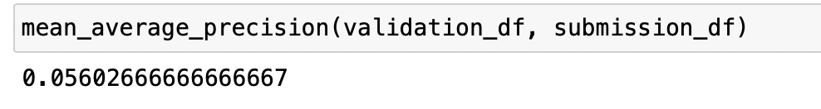
How does it work?
Mean Average Precision(MAP@5) in validation data:

